Slide 1
Do happier countries drink more or less than sad countries?
Rosanna, James, and Chris

Slide 2




Notes:
111 countries across 9 regions.
Determine what factors make people happy?
How does happiness compare across the world?
What differences between countries cause certain countries to be happier?
As intermediate conclusion could be that drinking affects happiness. However, as we factor in all categories it will show us the big picture on what factors truly contribute to an individual’s happiness.

Slide 3
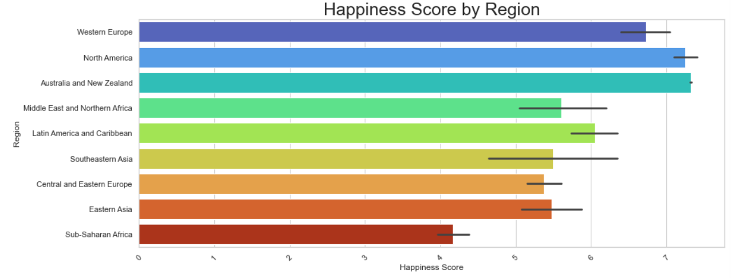
Notes:
What is Happiness score? We looked at 2 data sets from World Happiness Report and Happiness And Alcohol consumption report.
A metric measured by asking sampled people the following question: "How would you rate your happiness on a 1-10 scale”...
As we unfold our data findings, we will examine Happiness Score to various contributors SUCH AS: Monetary influences, Alcohol and Socioeconomic factors.
Australians, New Zealanders and North Americans are the Happiest people, while Sub- Saharan Africa along with Central and Eastern Europe are the least happy people.

Slide 4
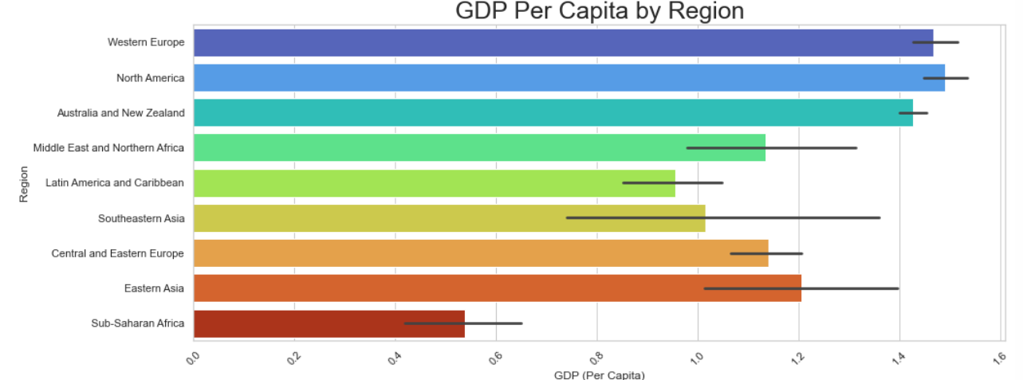
Notes:
Gross domestic product (GDP) is a monetary measure of the market value of all the final goods and services produced in a specific time period
North America Highest and Lowest GDP Sub- Saharan African

Slide 5
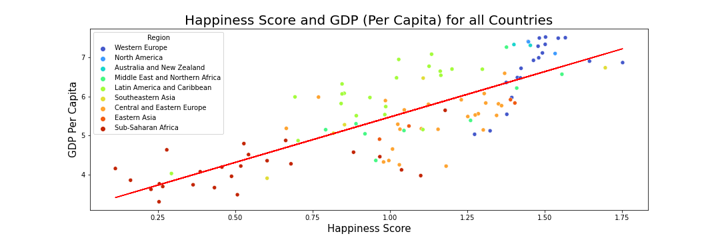
Is GDP related to Happiness?

Slide 6
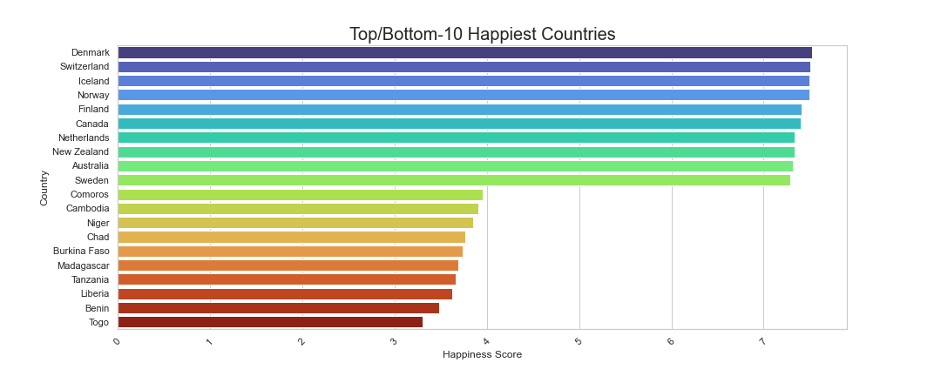
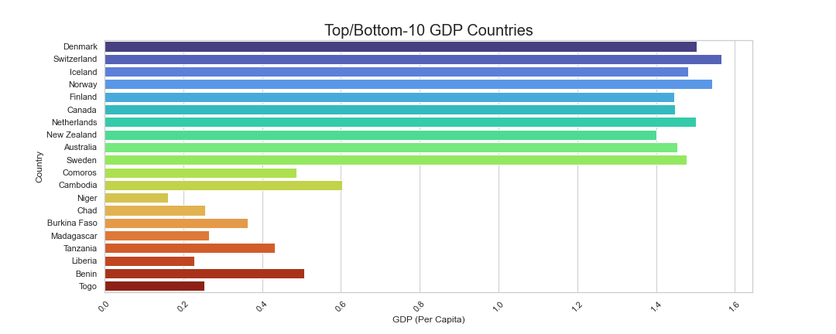
Comparing Happiness & GDP

Slide 7
Let’s dig deeper to find out more about happiness and why some countries are happier than others?
We found a dataset that included some information into what made up the Happiness Score for Countries/Regions . We merged the data to correlate with how these can possibly affect alcohol consumption .

Slide 8
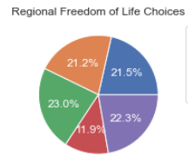
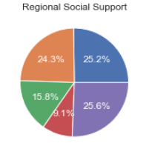
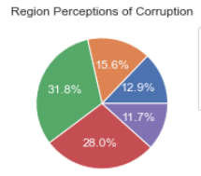
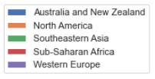
Freedom of life choices, Social Support and Perceptions of Corruption.
From this information Social Support stood out the most.
The more Social Support you have or take in can impact your freedom to make life choices and your perceptions of corruption.

Slide 9
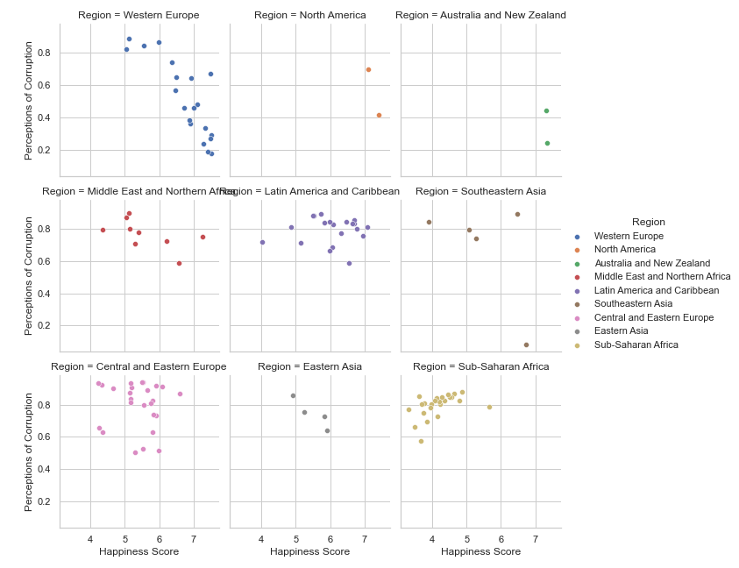
Interesting find digging further using a facet plot to compare regions and ….
Why a Facet Plot?
The Facet Plot is a space efficient way to view data.
Looking at SE Asia: here you can actually see that one of the countries has a low perception of corruption vs other countries in the region.

Slide 10
Now we understand why some countries are happy and sad.
Is there a Relationship between alcohol and happiness?
Do more sad countries drink more than other countries?

Slide 11
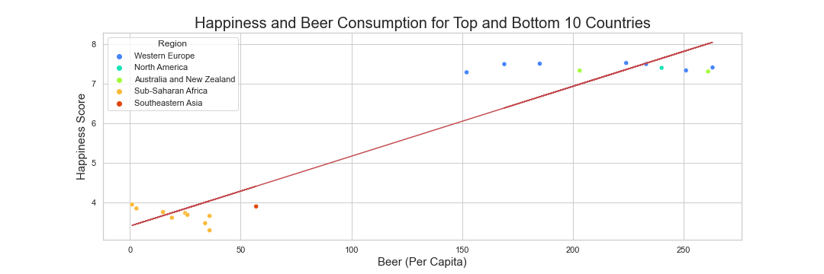
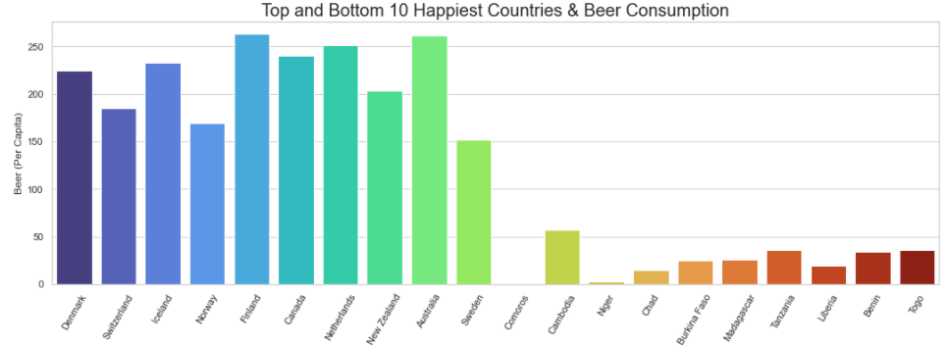
Beer consumption is consistent with GDP , Happiness Score, and Social economic based factors.

Slide 12
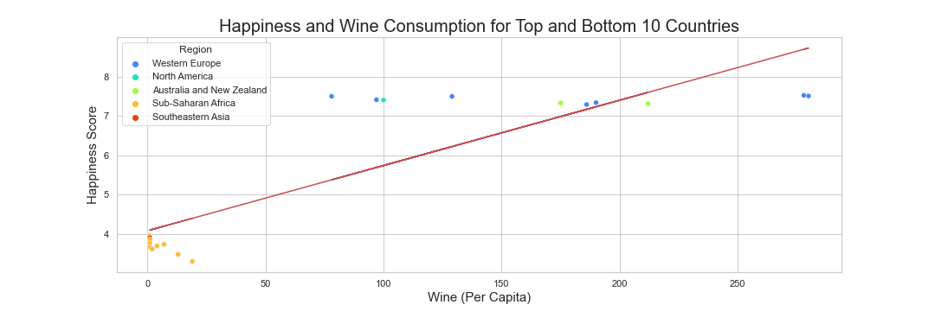
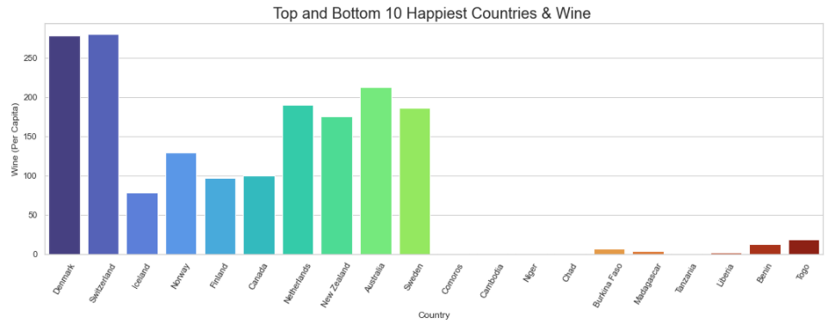
Wine consumption is consistent with GDP , Happiness Score, and Social economic based factors trending lower .

Slide 13
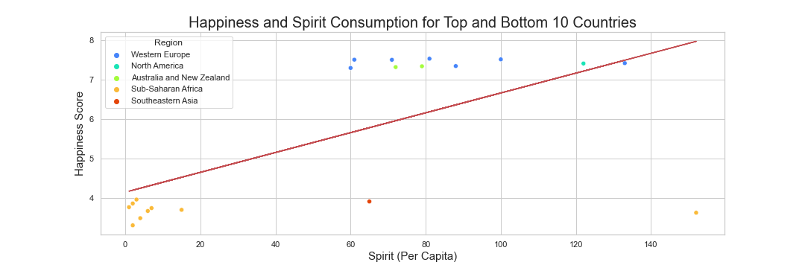
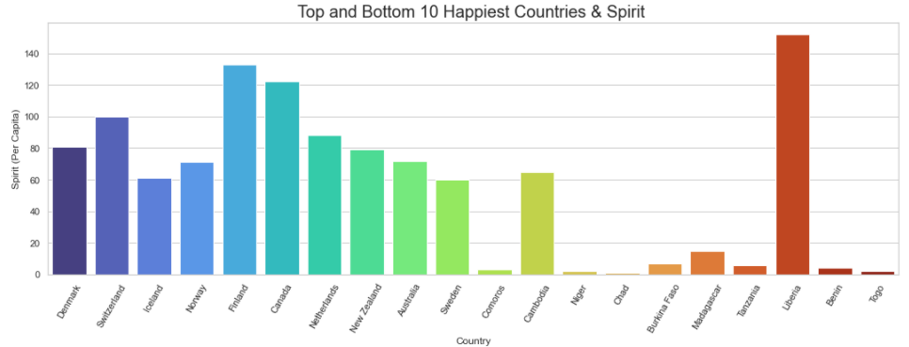
Spirits Consumption For SE Asia is low against the happiness score compared to Wine.
Sub-Saharan Africa continues to trend low.
Liberia out numbers the other countries

Slide 14
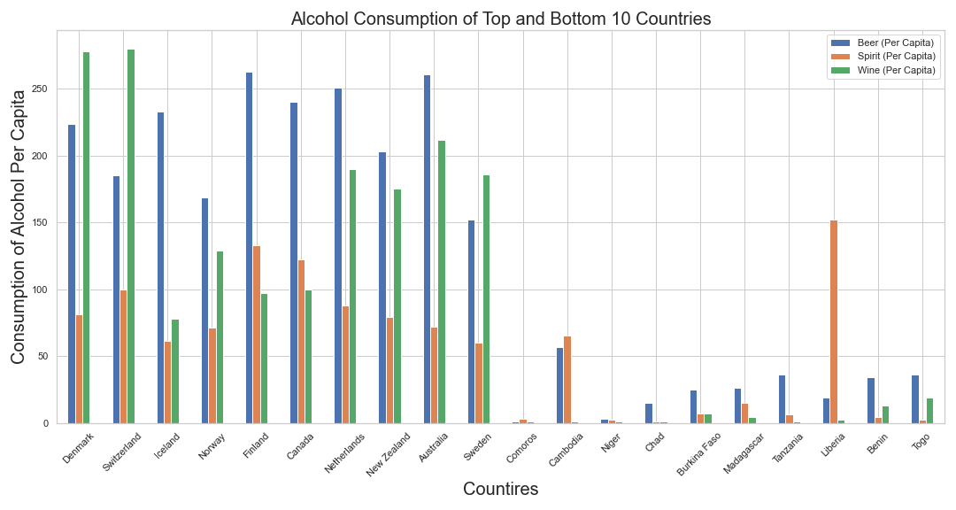
You have seen where alcohol consumption stands individually; Here we have a collective view on how it looks with all the Top/Bottom Ten Happiest countries. Another quick take away we have here is that Wine and Beer are in it for the number 1 spot!

Slide 15
How did we gather, clean, and finalize the data for analysis?

Slide 16
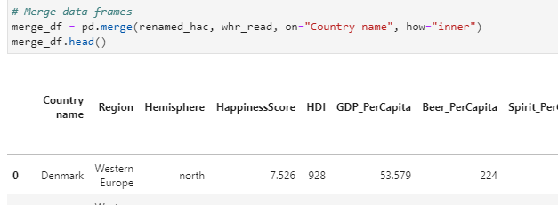
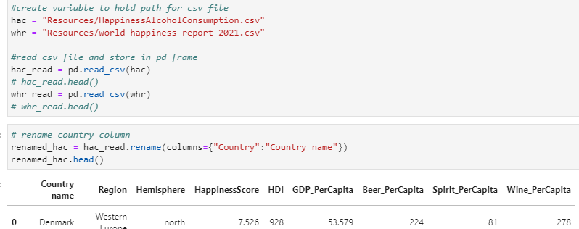
Gathering the Data
2 data sets were used from Kaggle.com. One of the columns in the data sets had to be renamed in order to merge them into one data frame

Slide 17
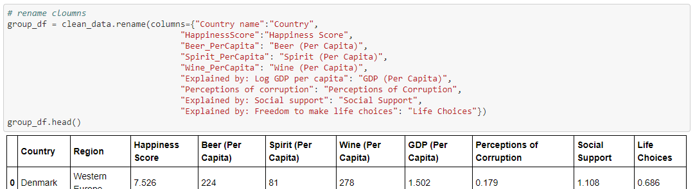
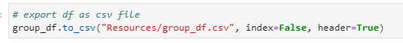
Cleaning the Data
Created new data frame and columns were renamed for the final group data frame for analysis
Data frame was exported into new csv file

Slide 18
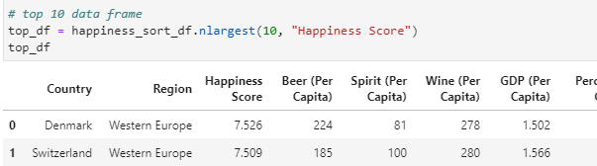
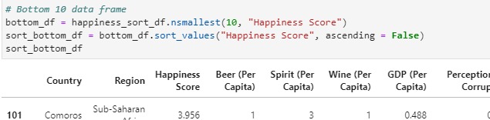
Finalizing the Data
Sorted data in descending order for happiness score for new data frame
Used .nlargest and .nsmallest for top and bottom 10 countries mankind 2 dataframes
Merged both data frames into one for analysis of top and bottom 10 countries

Slide 19
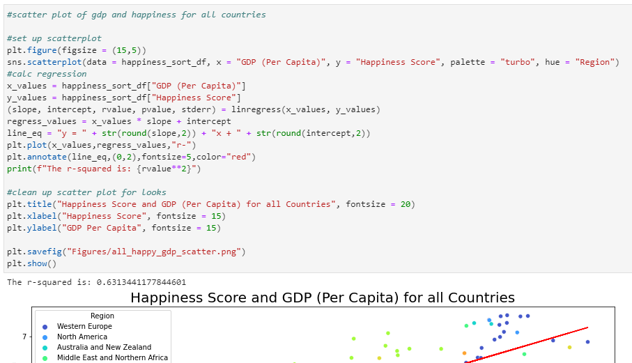
Analyzing the Data
Used Linear regression on scatter plots to analyze trends
.groupby was used to group the data by region for analysis
Bar charts and pie plots
R-value was used on scatter plots

Slide 20
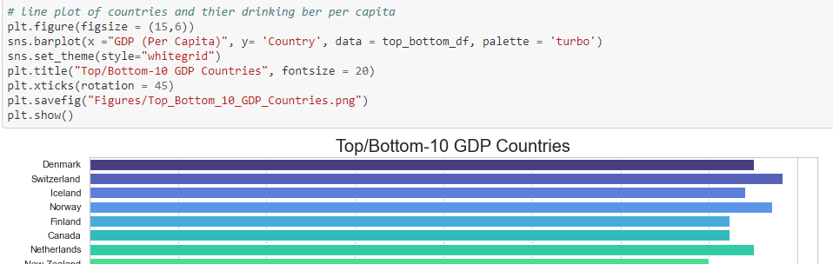
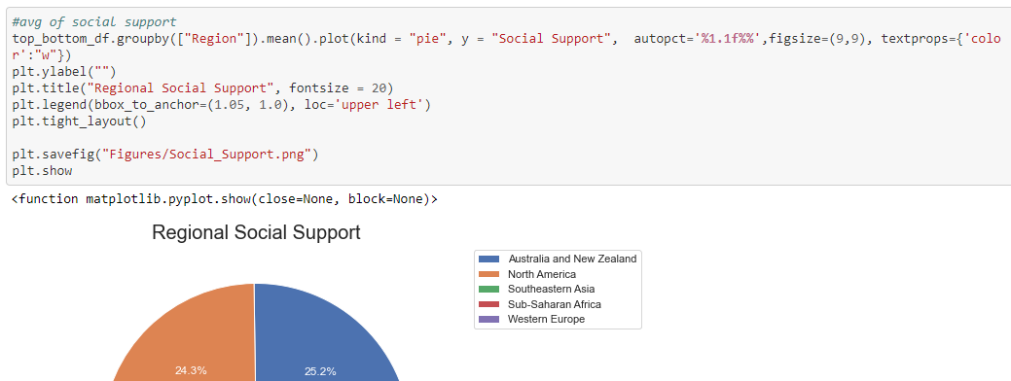
Visualizing the Data
The Seaborn library was used for more visually appealing bar charts and scatter plots
Matplotlib was used for our pie charts

Slide 21
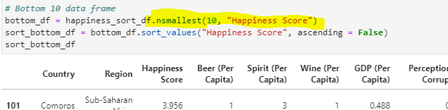
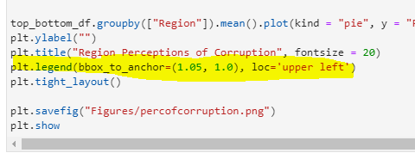
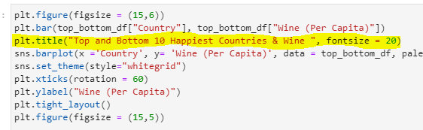
Challenges and Victories
Sorting the data in order to get the data for the top and bottom 10 countries
Moving the legend box from overlapping the pie chart
Understanding how seaborn works and debugging undefined variable

Slide 22
Conclusion
Discussion
Finding a relationship between happiness and drinking consumption is more complicated than we initially thought.
We needed to find what makes a country happier than others; and that involves analyzing social support, views of corruption, GDP, and freedom of life choices for each country and region
Findings
Strong correlation between a a countries’ happiness and GDP
Countries with higher social support, freedom of choices, and less views of corruption tend to have higher GDP and happiness scores
The region where a person lives also impacts a person’s happiness.
Sub-Sahara Africa and Southeast Asia vs. Western Europe and Australia and New Zealand
Final Thoughts
Initially we thought the less happy a country was, the higher drinking consumption they would have. However we found the opposite.
Is it because poor countries have less to spend or something else? More research is needed.

Slide 23
What questions do you have?

